Slide 1

Amazing Facts:
Stats, useless information, and figures you don’t know but probably should
Created by ESLTalkingPoints.com 2017 Free for use in classrooms

Slide 2
How to play...
Take turns to answer questions in your team
Award points for each correct answer
Teams cannot use outside sources to find the answer

Slide 3
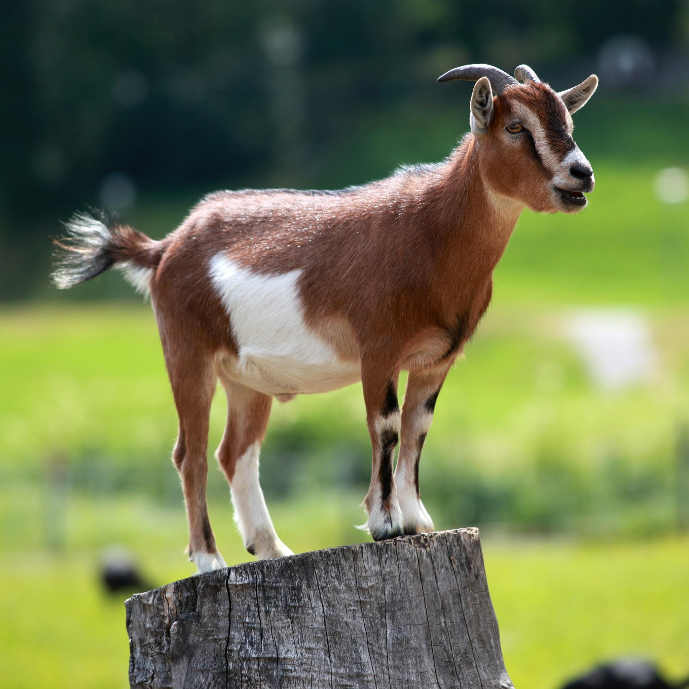
The first domesticated animals used for milk were cows. Is that true of false?
It’s unbelievably false. The very first animals that farmers used to raise and care for were actually goats and sheep. Both animals tend to be easier to shepard and are less fussy about what they eat.
Created by ESLTalkingPoints.com 2017 Free for use in classrooms

Slide 4
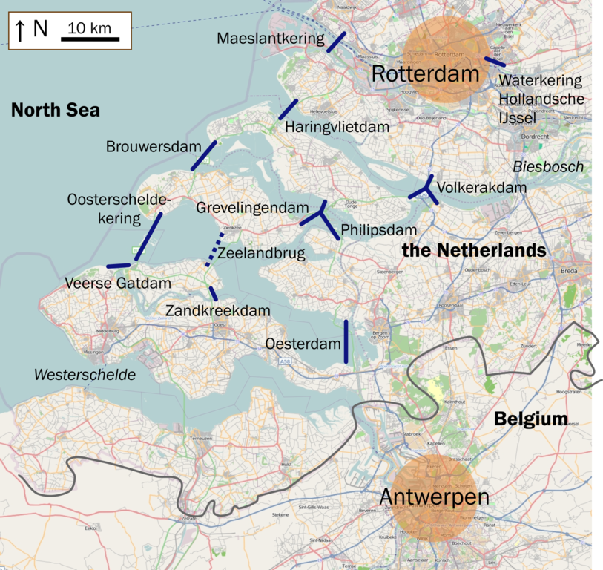
Almost 30% of Holland has been reclaimed from the sea. Is that true or false?
It’s actually false. Only 17% has been taken back from the sea, but interestingly, it also has 50% of its land area at least one meter below sea level. This could potentially cause problems in the future.
Created by ESLTalkingPoints.com 2017 Free for use in classrooms

Slide 5
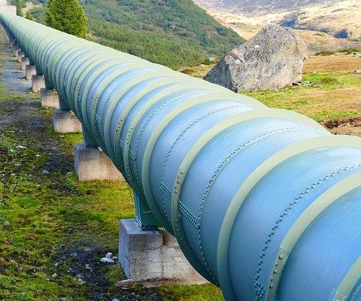
The oil transported from Alaska to the rest of the US via pipeline never freezes in winter. Is that true or false?
It’s surprisingly true! During the winter the oil travelling through the pipelines are heated to up to 25℃, thus ensuring it is fluid and can get it its destination
Created by ESLTalkingPoints.com 2017 Free for use in classrooms

Slide 6

A Boeing 747 is not able to fly upside down. Is that true or false?
It’s true! The weight distribution on the famous Boeing 747 is the reason why it isn’t able to do so. If it attempts to do so the wings would actually snap off.
Created by ESLTalkingPoints.com 2017 Free for use in classrooms

Slide 7
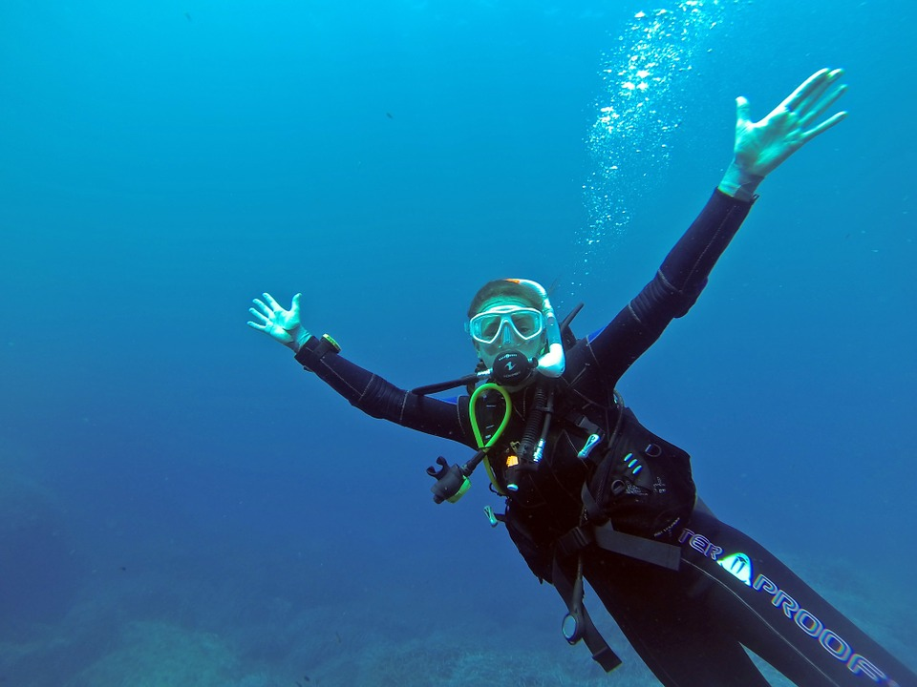
A scuba diver is not able to pass wind when they are below 10 meters. Is that true of false?
It’s strangely true. Once a diver goes below 10 meters the pressure caused from the water means that ‘air’ cannot be released.
Created by ESLTalkingPoints.com 2017 Free for use in classrooms

Slide 8
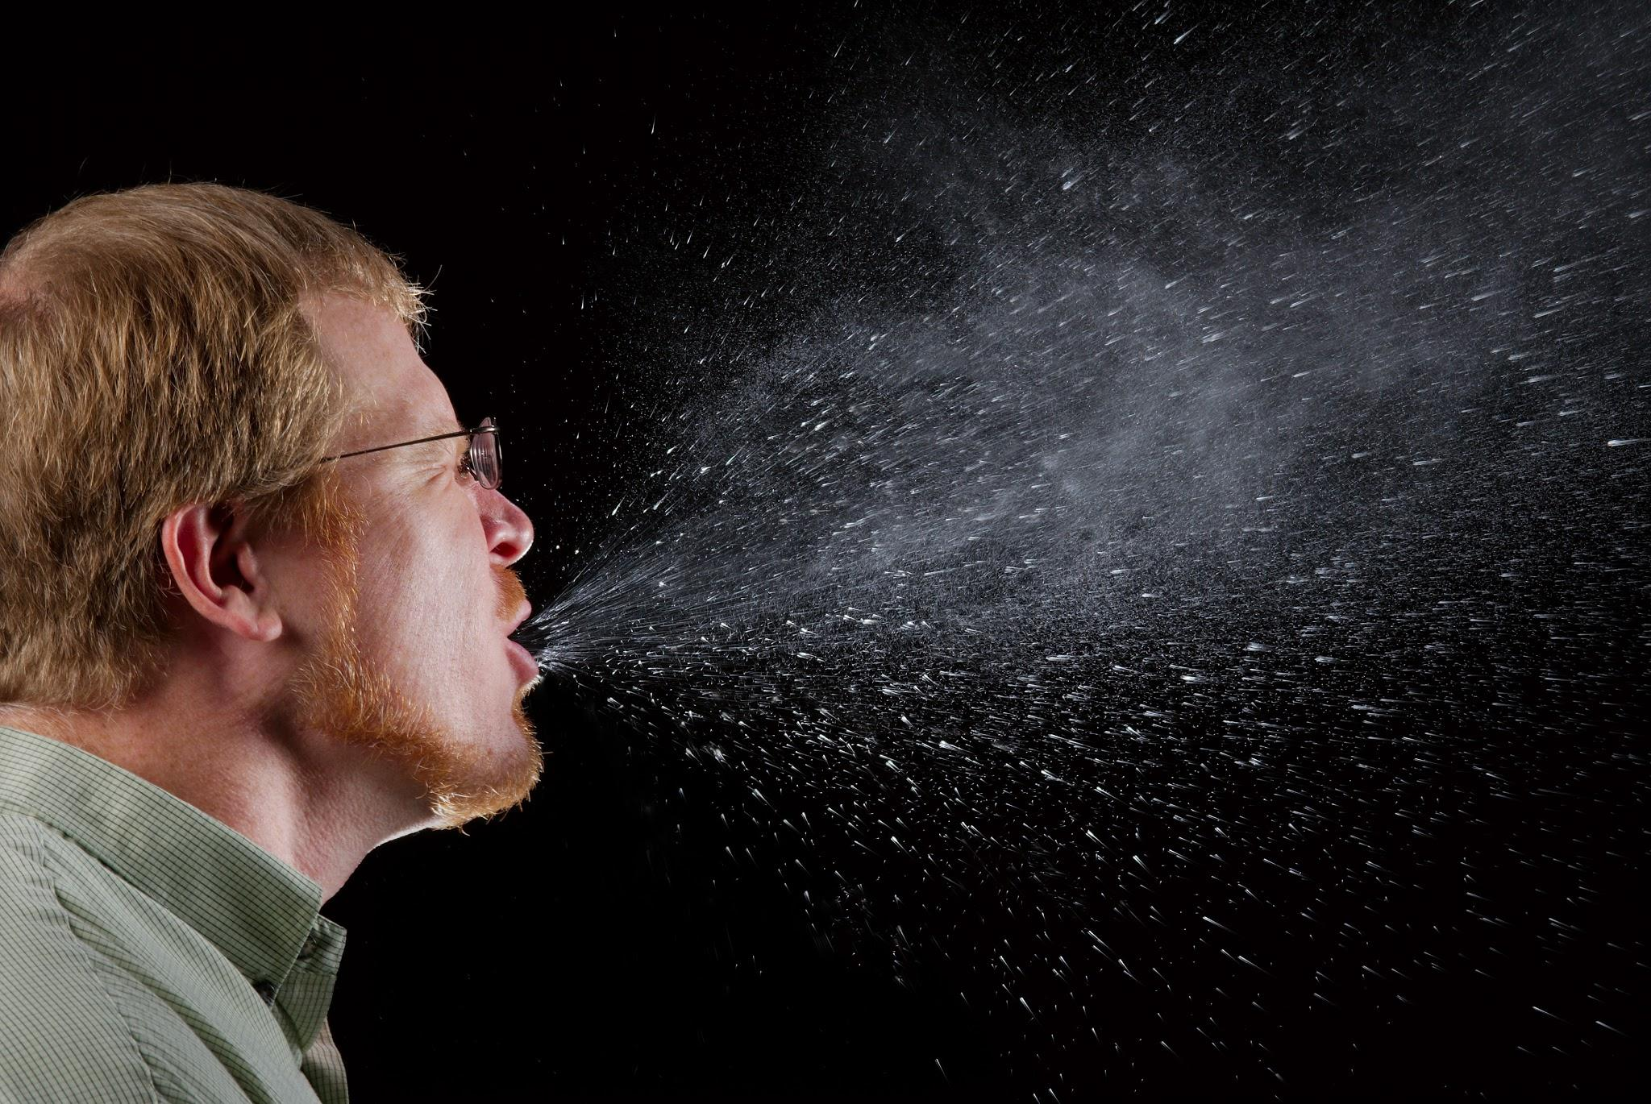
My mother used to tell me that it’s impossible to sneeze with your eyes open. Was she right?
She was right. Sneezing with your eyes open would cause them to pop out! Even more strangely there are some people who can do this, but they are an exception.
Created by ESLTalkingPoints.com 2017 Free for use in classrooms

Slide 9
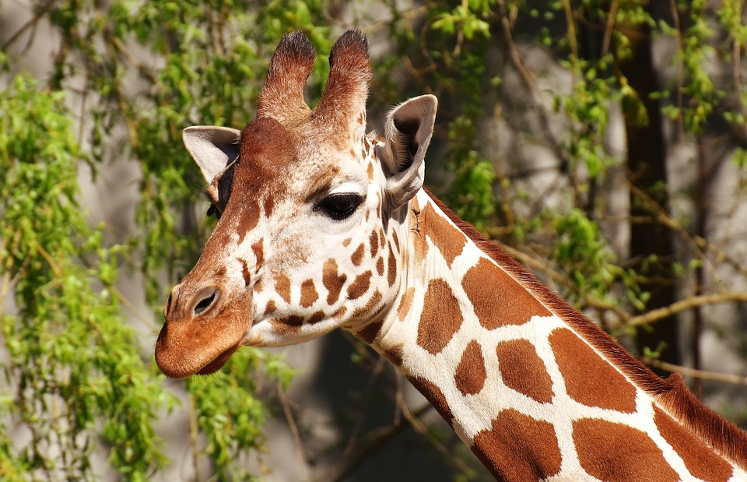
A giraffe can clean its ears with its tongue. Is that true of false?
It’s insanely true. A giraffe has a tongue that’s almost 50 cm long, which is just long enough!
Created by ESLTalkingPoints.com 2017 Free for use in classrooms

Slide 10

Left-handed people live longer than right-handed people. Is that true or false?
It’s unbelievably false. Even though it sounds strange but science has not been able to answer the question as to why left-handed people tend to live shorter lives.
Created by ESLTalkingPoints.com 2017 Free for use in classrooms

